Slide 3
1) Use multilink and base ten to represent these expressions.
a) 3$x$ $+$ 3 b) 4$x$
c) $x+$ 5 d) 2 $+$ 2$x$
2) Complete the function machines.
$=$ $x$
$=$ 1
$$y$$
$÷$ 5
$$y$$
$×$ 6

Slide 4
1) Use multilink and base ten to represent these expressions.
a) 3$x$ $+$ 3 b) 4$x$
c) $x+$ 5 d) 2 $+$ 2$x$
2) Complete the function machines.
$=$ $x$
$=$ 1
$$y$$
$÷$ 5
$\frac{y}{\text{5}}$
$$y$$
$×$ 6
6$y$

Slide 6
How much is there?
Substitution
50 p
$$+$$
20 p
$$+$$
20 p
$=$ 90 p

Slide 7
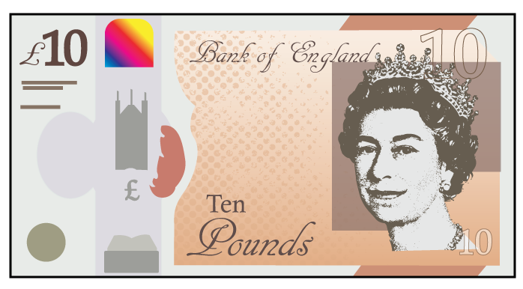
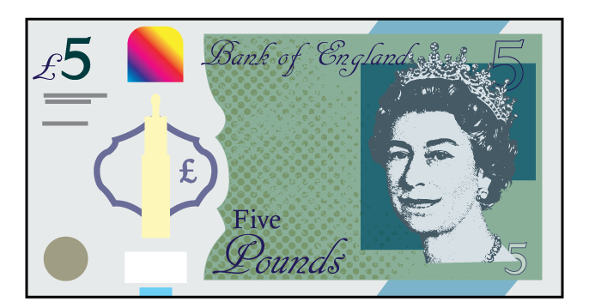
Substitution
Out | In
10 | 7
10
7

Slide 8
Have a think
$=$ 10
$=$ 5
What would be the totals of these calculations?
10
$$+$$
5
$$+$$
5
$$=$$
20
10
$$+$$
10
$$+$$
10
$$+$$
5
$$=$$
35

Slide 9
$=$ 10
$=$ 5
How many different ways could we total 30?
$$=$$
30
Have a think
$$=$$
30
$$=$$
30
$$=$$
30

Slide 10
Have a go at questions 1 - 2 on the worksheet

Slide 11
Have a think
If $x=$ 10
$($3 $×$ 10$)=$ 30
$x+$ 4 $=$ 14
$3x=$ 30
10 $+$ 4 $=$ 14
$\frac{x}{2}=$ 5
$2x+$ 1 $=$ 21
10 $÷$ 2 $=$ 5
20

Slide 12
Have a think
If $t=$ 5 and
$g=$ 6
$g−t=$ 1
3$t$ $+$ 4$g$ $+$ 6$g$ $+$ 7$t$ $=$ 110
6 $−$ 5
10$g$ $+$ 10$t$ $=$ 110
$\frac{\left(4t+5g\right)}{\text{10}}=$ 5
4$(g−t)$ $=$ 4

Slide 13
If $t=$ 5 and
$g=$ 6
$g−t=$ 1
3$t$ $+$ 4$g$ $+$ 6$g$ $+$ 7$t$ $=$ 110
10$g$ $+$ 10$t$ $=$ 110
20 $+$ 30
$\frac{\text{50}}{\text{10}}=$ 5
$\frac{\left(4t+5g\right)}{\text{10}}=$ 5
4$(g−t)$ $=$ 4
6 $−$ 5
$=$ 1

Slide 14
Have a think
If $m=$ $\frac{\text{1}}{\text{4}}$ and
$n=$ 0.2
work out the value of $m+$ 3$n$
$\frac{\text{1}}{\text{4}}$ $+$ 3(0.2)
$\frac{\text{1}}{\text{4}}$ $+$ 0.6
0.25 $+$ 0.6
$=$ 0.85

Slide 15
Write an algebraic expression that gives a value of 35
$a$ $=$ 10
I know! $a+a+a+$ 5
3$a+$ 5
4$a−$ 5
$\frac{a}{\text{2}}$ $×$ 7
Have a think

Slide 16
Have a go at the rest of the questions on the worksheet

