Slide 1


Slide 2
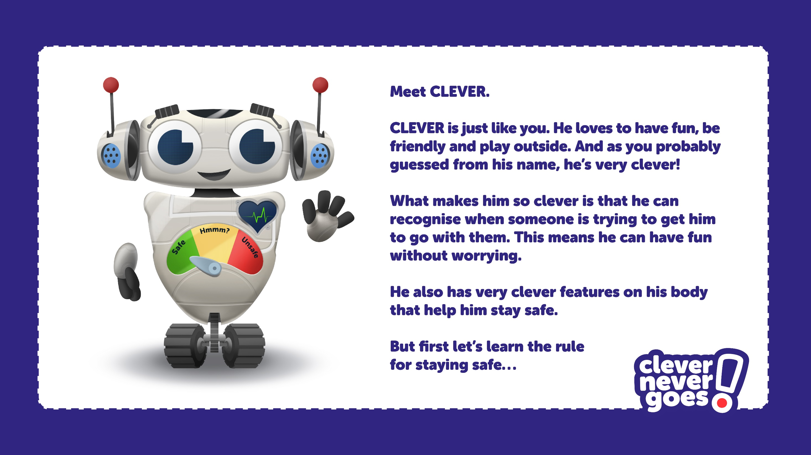

Slide 3


Slide 4
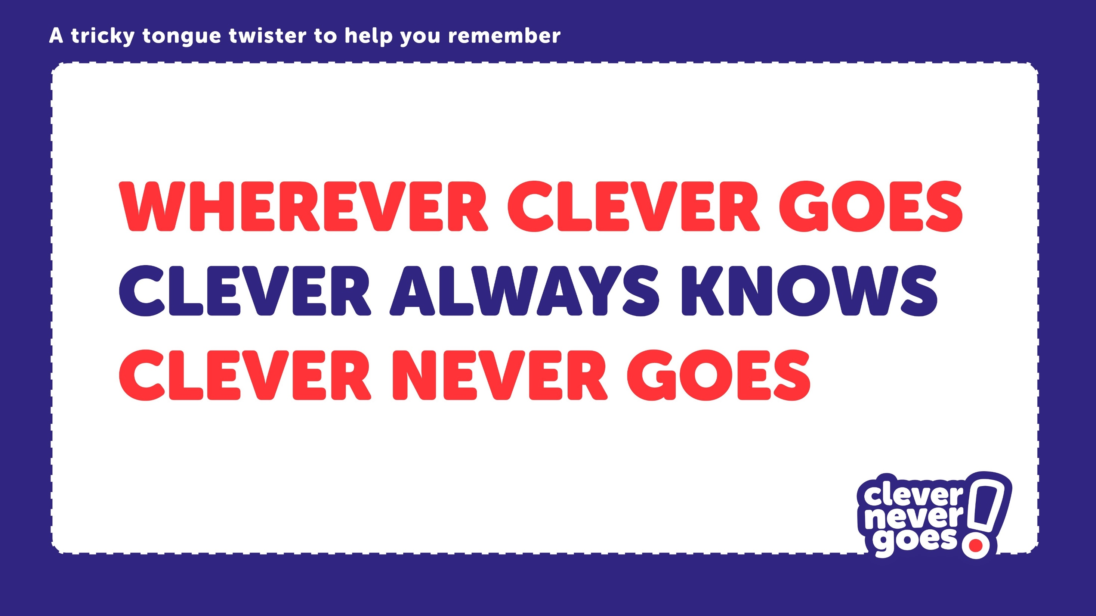

Slide 5

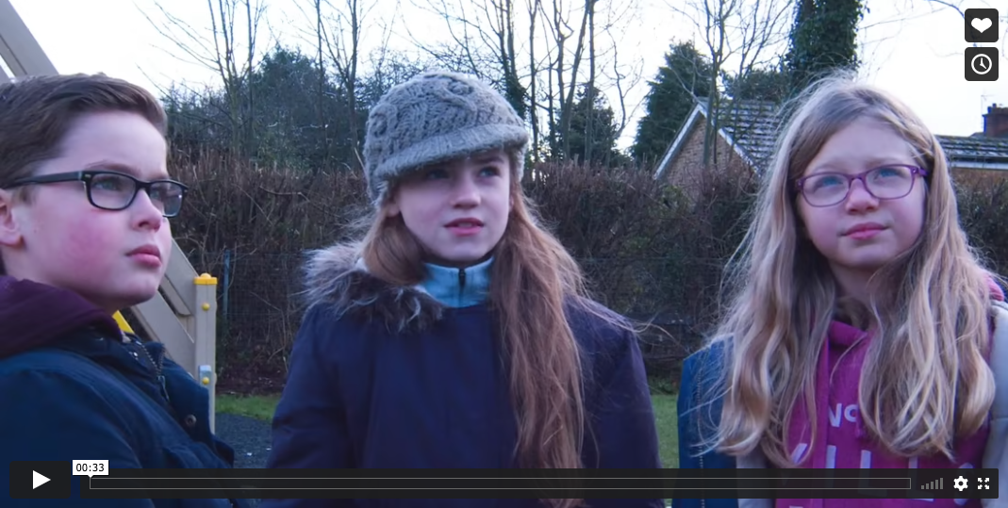
Click on the image or go to:
https://vimeo.com/563717528
to play the first “Go-Spotting” film.
The film is password protected (password = “clever”).

Slide 6
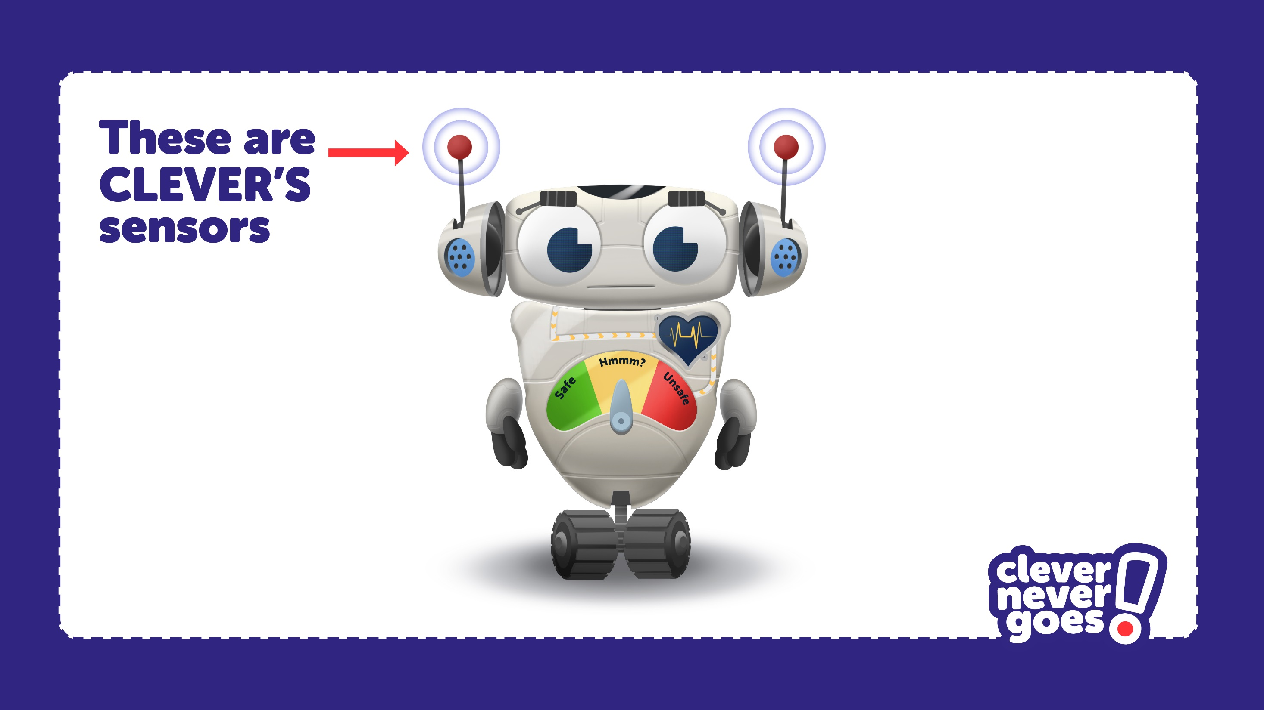

Slide 7
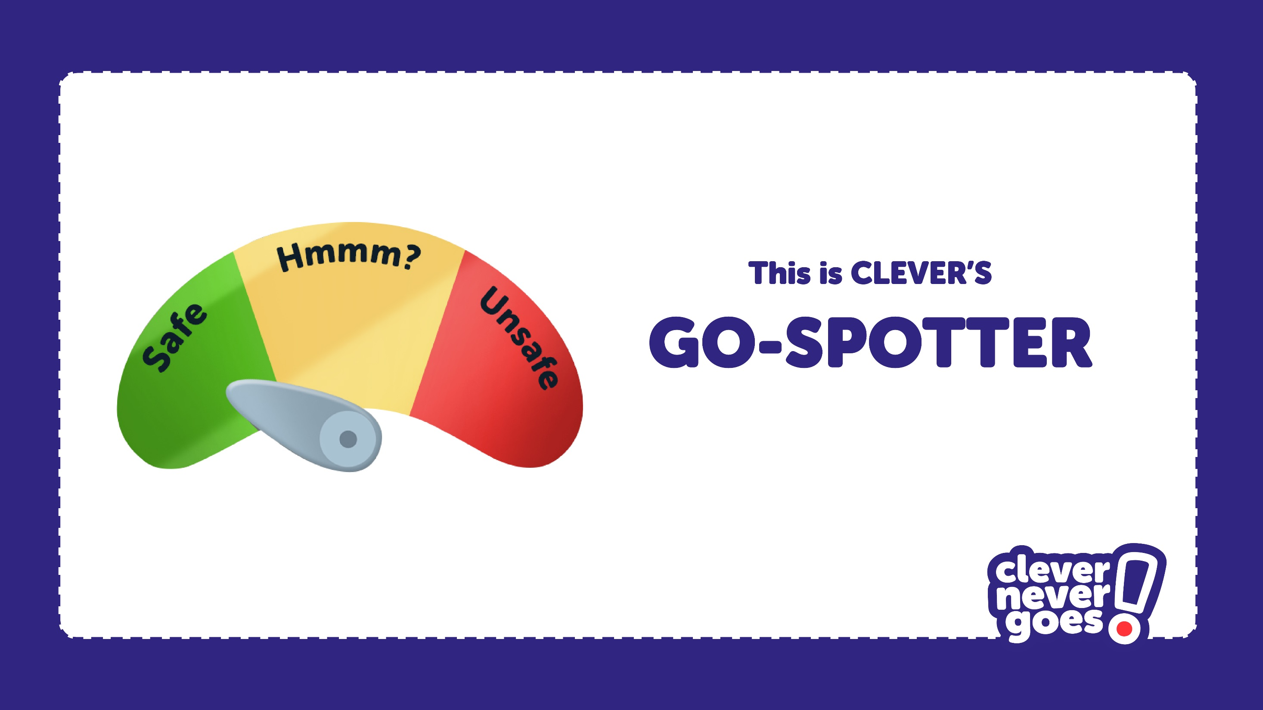

Slide 8
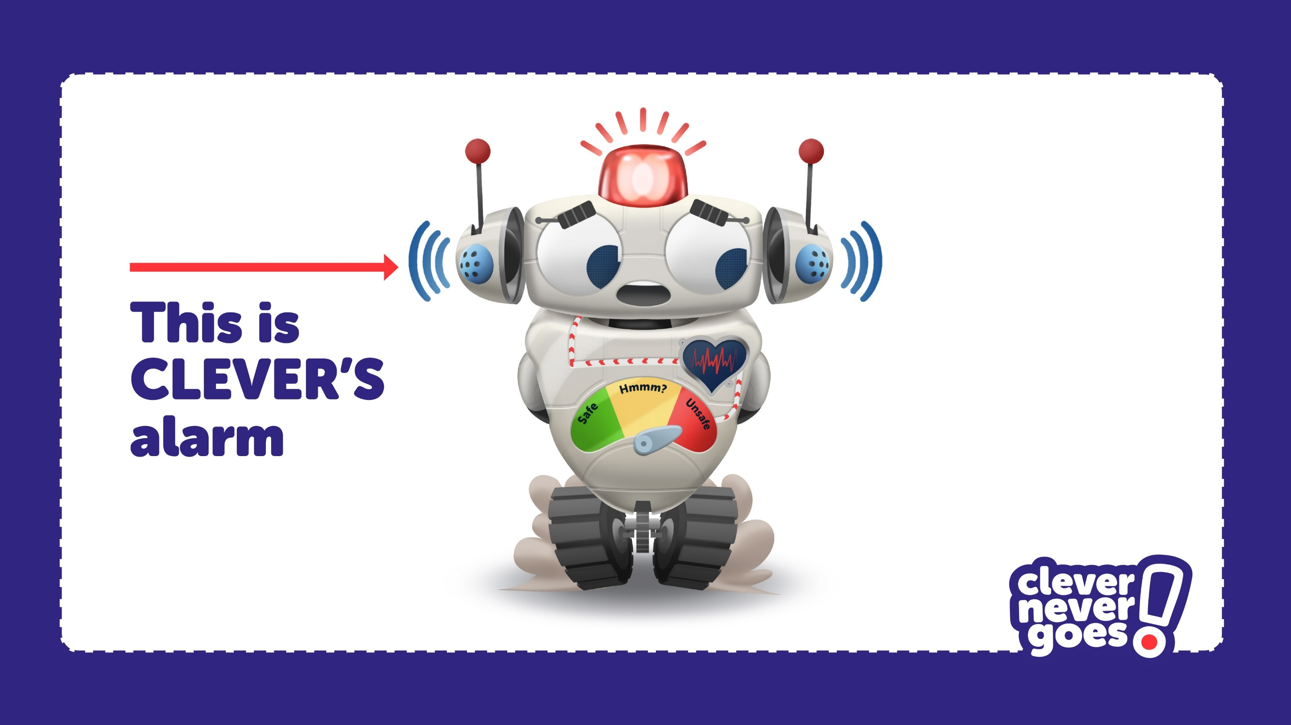

Slide 9
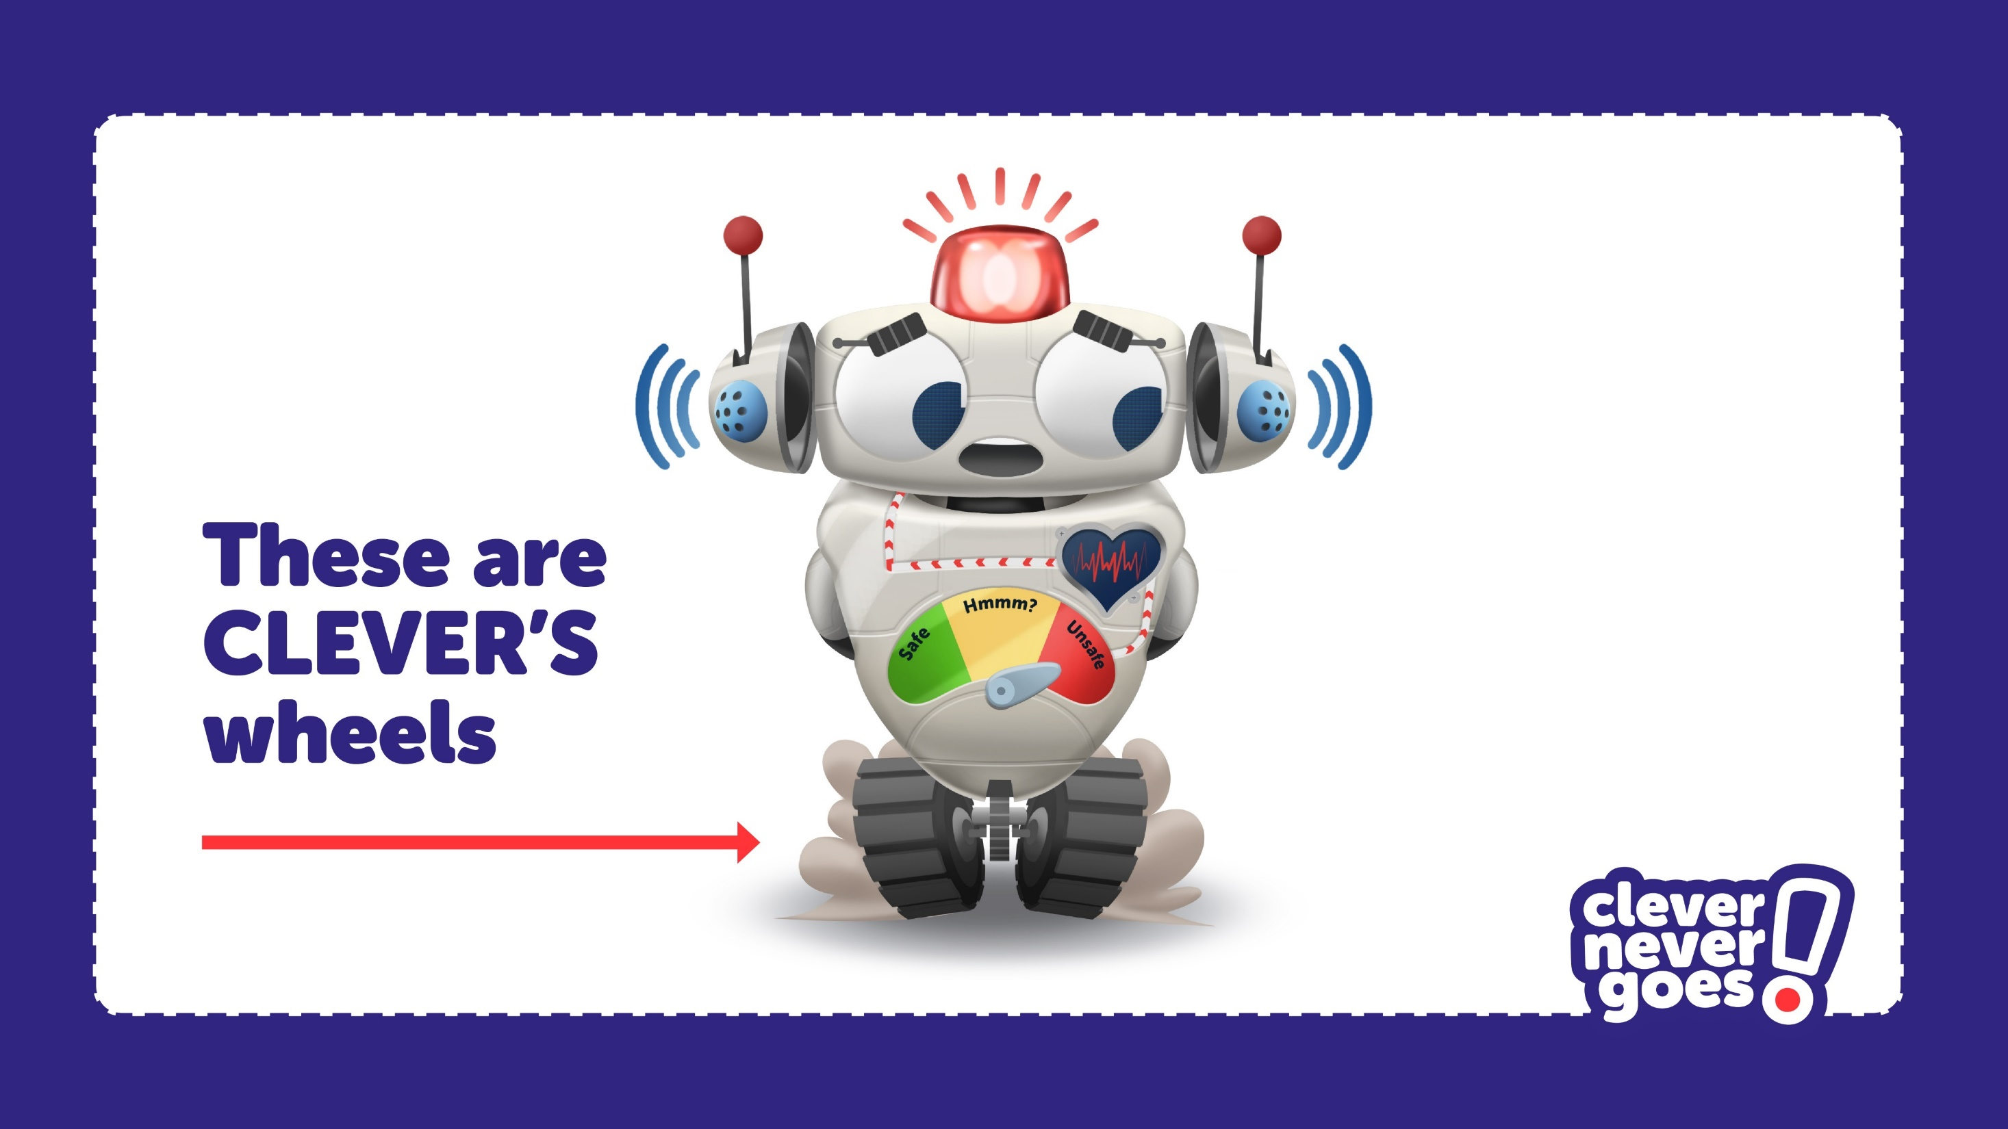

Slide 10
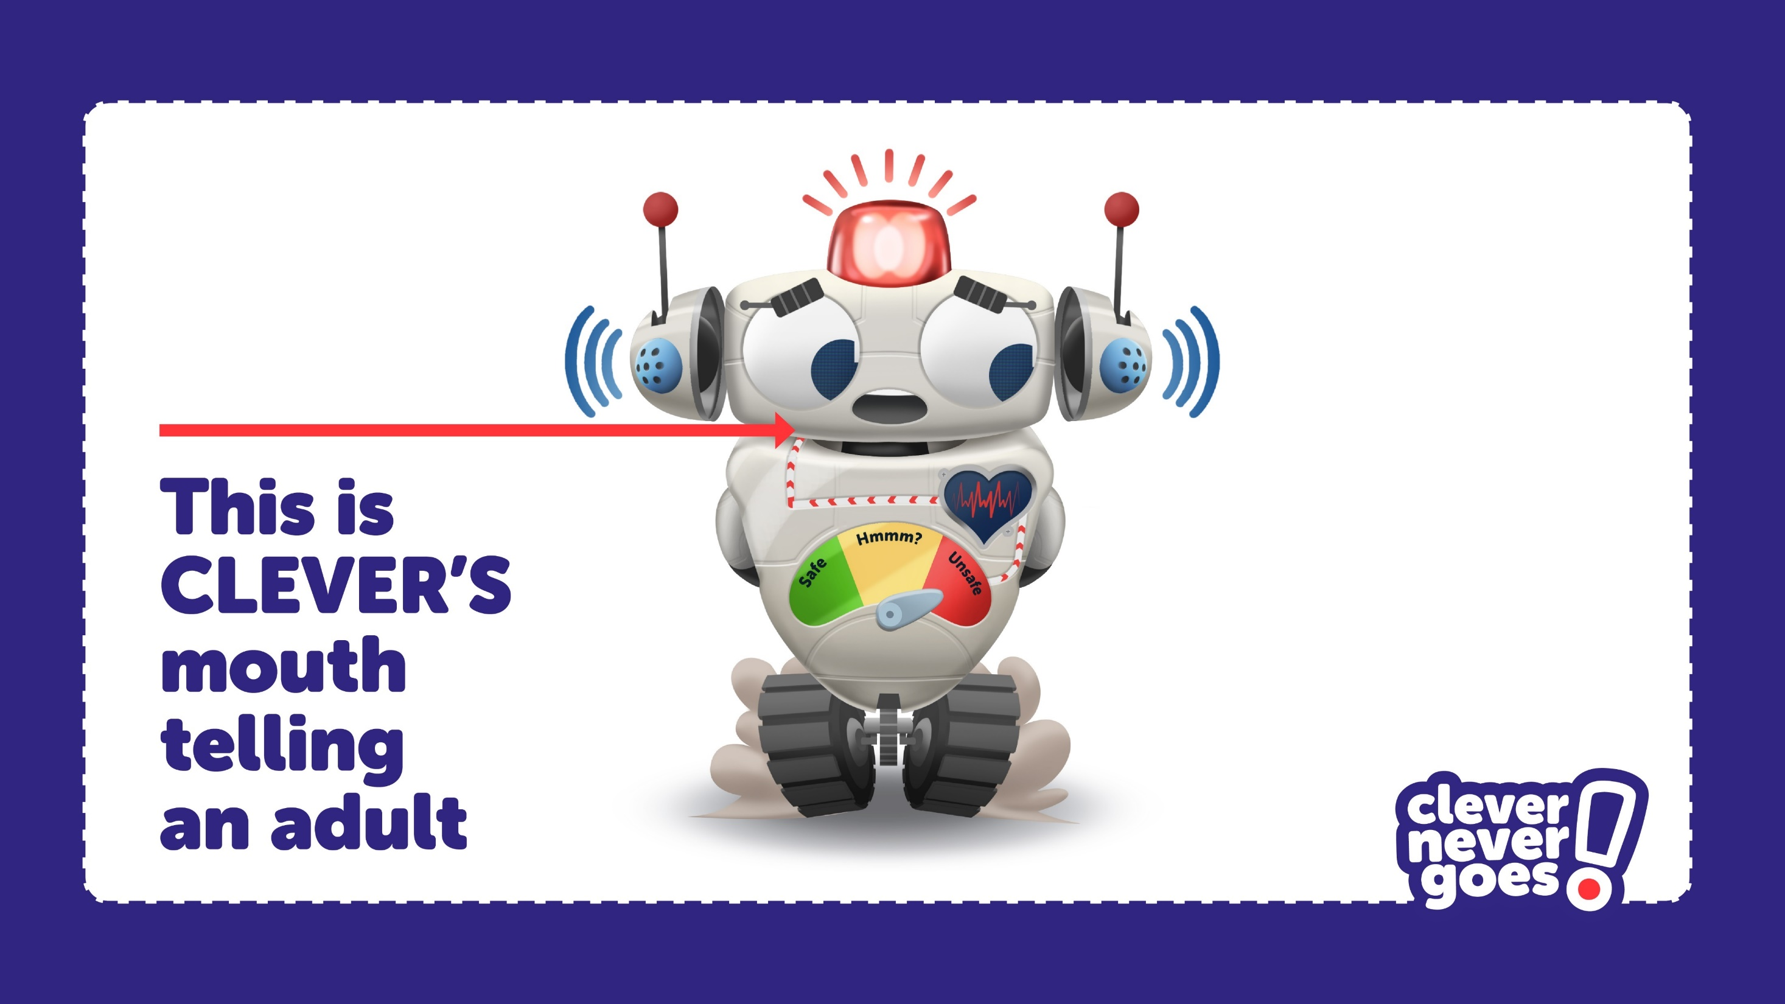

Slide 11
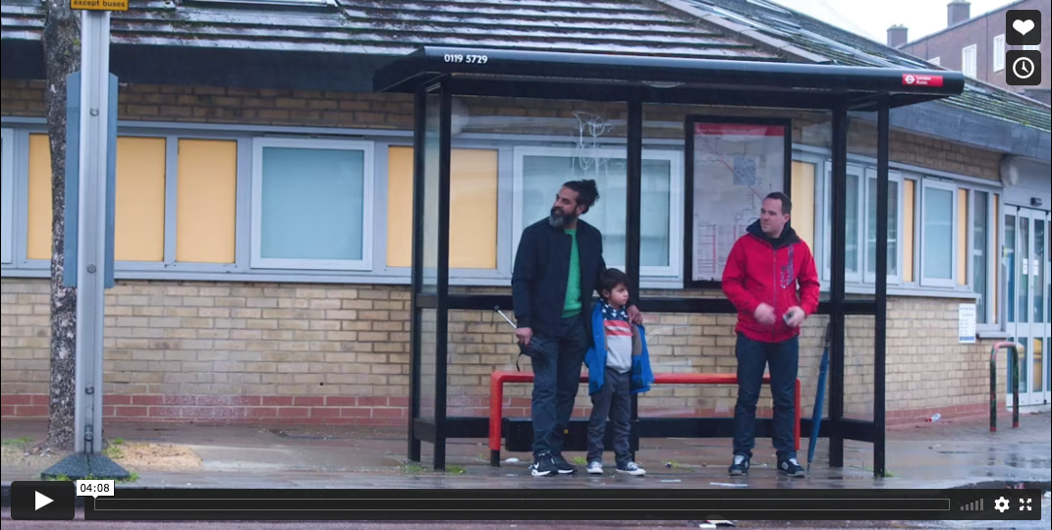
Click on the image or go to: https://vimeo.com/563704210
to play all 8 “Go-Spotting” films.
The film is password protected (password = “clever”).

Slide 12




