Slide 2
What Is ‘Kindness’?
Kindness is:
being friendly, generous and considerate of others;
showing goodwill to others;
being concerned when others are upset or worried;
helping people when they need you;
doing something nice for someone else, without expecting anything
in return.
What does ‘kindness’ mean to you?

Slide 3
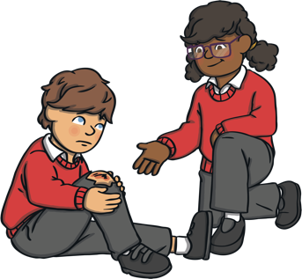
How Can You Show Kindness?
Smile!
Help someone if they
fall over.
Go and sit with someone who is sitting alone (if they want you to).
Sit next to someone at lunchtime you would not normally sit with.
Ask someone how they are.
Pick up litter.

Slide 4
How Can You Show Kindness?
Say good morning.
Write a letter to someone thanking them for something they’ve
done or said.
Say something nice to as many people as possible.
Let someone go ahead of you in the line.
Hold doors for others.

Slide 5
How Does Kindness Help Our School?
Doing kind things for others activates the parts of the brain that make you feel happy.

Slide 6
How Does Kindness Help Our School?
Kindness makes people feel that they belong and helps to reduce bullying.
Being kind helps you to make friends.

Slide 7
How Does Kindness Help Our School?
Kindness can help you concentrate, as the good chemicals in your brain
are released.

Slide 8
How Does Kindness Help Our School?
Kindness increases our sense of
well-being.

Slide 9
How Does Kindness Help Our School?
Being kind to people encourages them to be
kind too.

Slide 10
How Does Kindness Help Our School?
Kindness makes our world a better place for everyone!

Slide 11
Make the Choice
When you are kind, you make the world a happier, safer place.
You can be kind to everyone - to people who are just like you and to people who are different to you.
You have infinite kindness in you - share it with everyone, every day.
Choose kindness!

Slide 12
Make the Choice
Your smile might be the brightest light in someone’s day, so let your kindness shine - smile at whoever you can, whenever you can.
Choose kindness!

Slide 13
Talk About it…
Have you talked with thoughtful, caring words today?

Slide 14
Talk About it…
Have you shown understanding of someone’s feelings today?

Slide 15
Talk About it…
Have you helped someone today?

