Slide 1
Tuesday 29th June
Recognise a narrative hook.

Slide 2
Outcomes
Recall what happens in the raid.
Define the terms ‘opening sentence’ and ‘narrative hook’.
Create an opening sentence/narrative hook for the raid in chapter 5.

Slide 3
Recall Starter for Five! The Raid – Chapter Five
Where are Jim and his mother during the raid?
What has happened to Jim’s mother?
What does Jim hear?
How does Jim feel?
How has Jim shown courage and bravery? What has he done?
Extra Challenge: What do you think Jim’s next move will be?
In pairs, discuss the following recall questions about the raid in Chapter five.
Notes:
Extended starter activity. Could take up to 20 minutes.

Slide 4
Key Words
opening sentence – the first sentence of a story or new chapter.
narrative hook – when the opening of a story "hooks" the reader's attention so that he or she will keep on reading.
Remember, an opening sentence can be a narrative hook to draw the reader in.
First, let’s look at types of narrative hooks.
Notes:
Ss could write down key word or apply it to something they know.

Slide 5
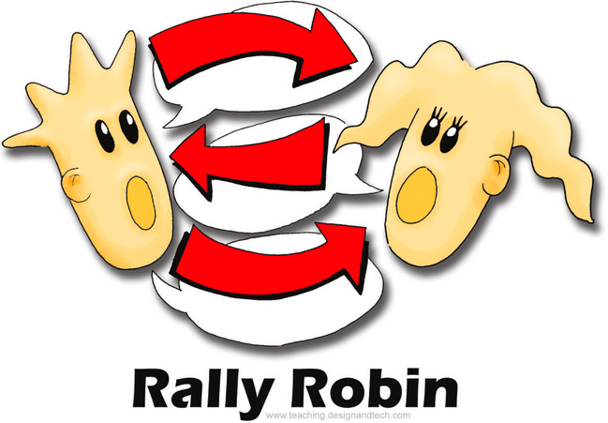
The puzzling hook: this immediately makes you ask questions of the story. Who? What? How? Etc. | ‘Jim and Silver moved through the darkening ship, taking care to keep to one side, out of sight of the deckhand of course.
The direct address hook: you are spoken to directly and feel involved from the start. | Do you ever think about being a pirate?
The subtle hook: this appeals to your sense of curiosity. Who is the seafaring man? | Jim started with the seafaring man.
The atmospheric hook: this is descriptive, and could create a mood. | A cold, wet and damp day in December. The clouds were so low they seemed to trail their mists in the treetops and already, at half past three it was dark within the forest.
The visual hook: appeals to our sense of sight. | The Hispaniola looked marvellous. Bottles of rum and fresh fruits and eager sailors. We even had cheese.
The funny hook: this is a tricky hook and only works if it appeals to your sense of humour. | When Jim Hawkins woke up on Monday morning, he found he was a pirate. He was standing, staring at himself in the mirror, quite baffled, when his mother swept in. ‘Why don’t you wear this cutlass and hat?’ she said.
The direct speech hook: this often means there is lots of action and a fast pace. | “I don’t care if your bride me with rum and gold,” said Jim, “the answer’s still no.”
In pairs, take it in turns to define the narrative hooks (Rally Robin).
Notes:
Ss to rally robin the definitions of the narrative hooks.
Hooks can be reduced for low ability students.

Slide 6
The puzzling hook: this immediately makes you ask questions of the story. Who? What? How? Etc. | ‘Jim and Silver moved through the darkening ship, taking care to keep to one side, out of sight of the deckhand of course.
The direct address hook: you are spoken to directly and feel involved from the start. | Do you ever think about being a pirate?
The subtle hook: this appeals to your sense of curiosity. Who is the seafaring man? | Jim started with the seafaring man.
The atmospheric hook: this is descriptive, and could create a mood. | A cold, wet and damp day in December. The clouds were so low they seemed to trail their mists in the treetops and already, at half past three it was dark within the forest.
The visual hook: appeals to our sense of sight. | The Hispaniola looked marvellous. Bottles of rum and fresh fruits and eager sailors. We even had cheese.
The funny hook: this is a tricky hook and only works if it appeals to your sense of humour. | When Jim Hawkins woke up on Monday morning, he found he was a pirate. He was standing, staring at himself in the mirror, quite baffled, when his mother swept in. ‘Why don’t you wear this cutlass and hat?’ she said.
The direct speech hook: this often means there is lots of action and a fast pace. | “I don’t care if your bride me with rum and gold,” said Jim, “the answer’s still no.”
Which hooks would be most appropriate for the raid in Chapter Five?
Think about what has happened to Jim and his mother and how they might be feeling.
Notes:
Ss to rally robin the definitions of the narrative hooks.

Slide 7
Stevenson’s Opening Sentences
It was not long after that the first mysterious event happened and we saw the last of the captain.
All that night we were in a great bustle getting things stowed in their place. Boatfuls of the squire’s friends came to wish him a good voyage and a safe return.
The appearance of the island when I came on deck next morning was altogether changed.
The red glare of the torch, lighting up the interior of the block-house, showed that the worst of my fears had come true. The pirates were in possession of the house and stores.
Now look at the Stevenson’s opening sentences from Treasure Island. How do the openings impact on the reader?
Are any of them narrative hooks? How?
Are they effective? Why?
Does the sentence move the plot forward – e.g. time of day; outside to inside the inn; different place; introduce a problem etc.?
Notes:
Ss could discuss sentences with their partner, or it could be a carousel activity.

Slide 8
The puzzling hook:
this immediately makes you ask questions of the story. Who? What? How? Etc.
The direct address hook:
you are spoken to directly and feel involved from the start.
The subtle hook:
this appeals to your sense of curiosity.
The atmospheric hook:
this is descriptive, and could create a mood.
The visual hook:
appeals to our sense of sight.
The funny hook:
This is a tricky hook and only works if it appeals to your sense of humour.
The direct speech hook:
This often means there is lots of action and a fast pace.
Task
Imagine you are Jim. Choose an appropriate hook to begin telling the story of the raid.
Think specifically about how Jim is feeling and the atmosphere you want to create. It is probably very tense and emotional for Jim and his mother.
Extra Challenge: Look back at Stevenson’s opening sentences and mimic his style.
Notes:
Ss could discuss sentences with their partner, or it could be a carousel activity.

Slide 9
Plenary: Key Word Check!
Opening sentence
Narrative hook
The puzzling hook
The direct address hook
The subtle hook
The atmospheric hook
The visual hook
The funny hook
The direct speech hook
In pairs, take it in turns to define the key words (Rally Robin).
Notes:
Ss could rally robin the definitions of the key words.

