Slide 2
Feedback: “Is the refugee crisis really over?”
“It is pretty much over but we do not know what will happen in the future.”
Homerswood Primary & Nursery School
“The crisis is not over because there will always be places that people will need to escape from; there are so many problems around the world such as persecution, natural disasters and war that are happening right now.”
Barley Croft Primary School
“We should do everything we can to try and help refugees who come to our country as we are lucky not to have to any problems which make us need to flee.”
Barley Croft Primary School
Yes
No
“I think the refugee crisis is not over. Just because it is not reported it doesn't mean that it is not happening.”
Homerswood Primary & Nursery School
13.9%
86.1%
“According to the bar graph there are still refugees coming UK which means Refugee Crisis is really not over. We need to help each other.”
Chingford C of E School

Slide 3
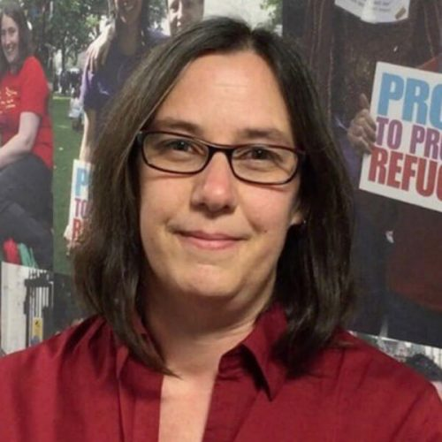
Feedback: “Is the refugee crisis really over?”
“It is great to see that so many of you feel this is still an important issue, even though it is not in the news headlines as much as it used to be. For people who have had to leave everything behind, there will always be a need for other countries to provide them with safety and protection.”
Dr Lisa Doyle, Director of Advocacy & Engagement at Refugee Council
0:00-1:21
Click the image to hear from Steve Ballinger, who is Director of Communications at British Future. He was very interested in your views on this topic!
The VoteTopic results were shared with…
Refugee Week
Refugee Action
Refugee Council
Asylum Matters
Choose Love
https://safeshare.tv/x/Mmtki-SXNsU
Notes:
Alternative Video Link: https://youtu.be/Mmtki-SXNsU
Images
https://www.ecre.org/staff/board/
https://www.britishfuture.org/about-us/who-we-are/
https://refugeeweek.org.uk/resources/free-materials/downloadable-materials/the-refugee-week-logo/
https://www.refugee-action.org.uk/andy-gregg-appointed-interim-chair-refugee-action/new-refugee-action-logo-jpg/
https://www.refugeecouncil.org.uk/
https://asylummatters.org/
https://helprefugees.org/choose-love/

Slide 4
Starter: At the doctors…
Pair activity (3-5 mins)
Talk to the person next to you and tell them about a time that you went to the hospital or to see a doctor. Why did you go and what happened?
I went to the doctor because…
Challenge:
After you’ve been to the doctor, they write it down in a report. What do you think happens with this report?
Notes:
Images
iStock

Slide 5
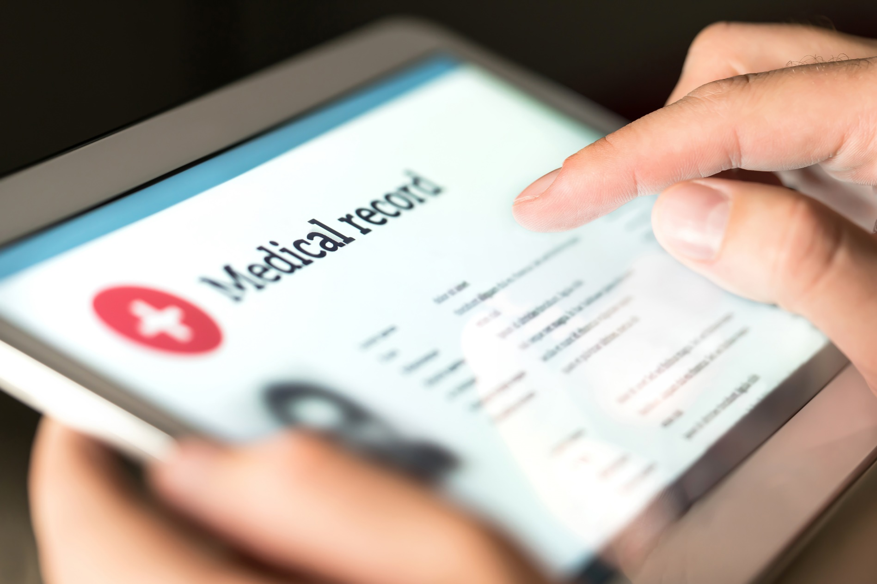
Should we share our medical data?
Data:
Information that is collected to be examined and considered and used to help make decisions, or information in an electronic form that can be stored and used by a computer
Notes:
Images
iStock
References
https://dictionary.cambridge.org/dictionary/english/data

Slide 6
Starter: At the doctors…
Why are we talking about this?
Into the future…
What is medical data?
To share or not to share?
Vote!
Notes:
Images
Icons8

Slide 7
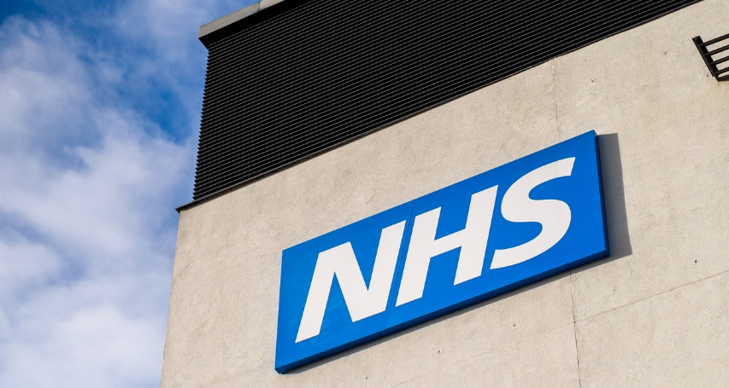
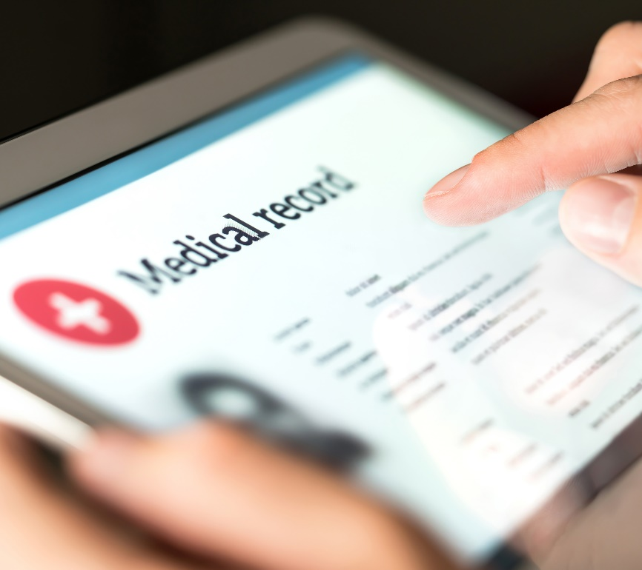
Why are we talking about this?
When you visit the doctor or hospital in the UK, you will be probably be looked after by the NHS.
The NHS stands for the National Health Service. Many of the doctors and nurses in the UK work for them.
The NHS will write down information about your visit. This information helps them to look after you, and means that other doctors can see what treatment you have received.
From September, a part of the NHS called NHS Digital are going to start sharing this medical information with other groups to learn more about different illnesses and make plans for how they can treat people in the future.
Notes:
Images:
iStock
References:
https://digital.nhs.uk/
https://www.nhs.uk/your-nhs-data-matters/

Slide 8
Starter: At the doctors…
Why are we talking about this?
Into the future…
What is medical data?
To share or not to share?
Vote!
Notes:
Images
Icons8

Slide 9
What is medical data?
As you learned before, NHS Digital is going to start sharing people’s medical data with researchers and scientists to help them learn more about different illnesses and plan for how they can help people.
What data will be shared? (2-3 mins)
Take a look at the different data from your medical record below. Which pieces of data do you think that NHS Digital would like to share with trusted scientists and researchers?
What medication you take
Which vaccines you have had
Your ethnicity
If you have allergies
If you have been to hospital
Your contact information
Your name
If you have an illness/condition
Your address
Notes:
Images:
1) Icons8
References:
1) https://www.nhs.uk/using-the-nhs/about-the-nhs/how-to-access-your-health-records/

Slide 10
What is medical data?
What medication you take
If you have allergies
Which vaccines you have had
All of this information will be shared by NHS Digital.
Your ethnicity
If you have been to hospital
If you have an illness/condition
This information will not be shared by NHS Digital.
Your address
Your contact information
Your name
First thoughts? (3-4 mins)
Now that you know what information NHS Digital wants to share, how do you feel and why? Share your answer with the class.
Challenge:
If you were voting now, how would you vote? At the end of the lesson, see if you’ve changed your mind!
Notes:
Images:
Icons8
References:
https://www.nhs.uk/using-the-nhs/about-the-nhs/how-to-access-your-health-records/

Slide 11
Starter: At the doctors…
Why are we talking about this?
Into the future…
What is medical data?
To share or not to share?
Vote!
Notes:
Images
Icons8

Slide 12
Into the future…
The sharing of medical data has been in the news a lot recently, and has even been called “The NHS Data Grab”.
This probably won’t happen!
There are lots of different opinions about it. Some people think it is a great idea that will help in the future, whereas others are worried about what could happen to their data.
This could happen…
Into the future… (8-15 mins) On the next few slides, you are going to hear some different opinions about sharing medical data. After you’ve read each one, you will find out some facts about the opinion. Then, it’s your job to decide how likely you think it is to happen. Use your fingers to show your answer, based on the instructions on the right!
This probably will happen!
Notes:
Images:
iStock
Pixabay
References:
https://www.bbc.co.uk/news/technology-57555013

Slide 13
Into the future…
Opinion:
Eventually, our data will be sold to other people, like insurance companies and health apps, who will then try to sell us things.
This probably won’t happen!
This could happen…
Fact:
NHS Digital have said that the data will only be used for health and care planning purposes, or for research. The only people who can access it are those who have a good reason to use it.
This probably will happen!
Do you think that medical data could be sold to other groups and businesses?
Notes:
Images:
Pixabay
References:
https://digital.nhs.uk/coronavirus/coronavirus-data-services-updates/trusted-research-environment-service-for-England

Slide 14
Into the future…
Opinion:
This probably won’t happen!
It is likely that there will be data leaks in the future where people’s information could be hacked or stolen.
This could happen…
Fact:
The NHS have said that they will protect people’s personal information such as their name and postcode by swapping this information for a random code or a nickname (known as pseudonymisation).
This probably will happen!
Do you think that medical data could be leaked or stolen?
Notes:
Images:
Pixabay
References:
1) https://digital.nhs.uk/coronavirus/coronavirus-data-services-updates/trusted-research-environment-service-for-england

Slide 15
Into the future…
Opinion:
Patients will worry about talking to their doctor because they won’t know who else will know what they’ve said.
This probably won’t happen!
This could happen…
Fact:
Some companies and an MP are trying to stop the data sharing. They say that the NHS data could be sold to other companies. However, NHS Digital says that only those who are “trusted researchers” can access the data.
This probably will happen!
Do you think that people will be worried about talking to doctors?
Notes:
Images:
Pixabay
References:
1) https://digital.nhs.uk/coronavirus/coronavirus-data-services-updates/trusted-research-environment-service-for-england

Slide 16
Into the future…
Opinion:
This probably won’t happen!
Having all the data in one place means that scientists can fight new diseases and help more people.
This could happen…
Fact:
Throughout the pandemic the Government have said that the “data” has helped them know when to go into lockdown, when to open up, and how to save lives. They say that sharing data will only help more.
This probably will happen!
Do you think that medical data could help to save lives?
Notes:
Images:
Pixabay
References:
1) https://digital.nhs.uk/coronavirus/coronavirus-data-services-updates/trusted-research-environment-service-for-england

Slide 17
Starter: At the doctors…
Why are we talking about this?
Into the future…
What is medical data?
To share or not to share?
Vote!
Notes:
Images
Icons8

Slide 18
To share or not to share?
Where do you stand? (5-15 mins)
Now you are going to see some different opinions about sharing medical data. For each one, if you agree, move to the left. If you disagree, move to the right. Not sure? Stand in the middle!
I agree!
I disagree!
Notes:
Images:
1) iStock

Slide 19
To share or not to share?
Sharing medical data helped doctors to learn about vaccine side effects and how to help people who were ill with Coronavirus. If data can help us, we should share it.
I agree!
I disagree!
Notes:
Images:
1) iStock

Slide 20
To share or not to share?
The data will all be “de-identified”, so it doesn’t matter much to me. As long as it’s only being shared with scientists and researchers who want to understand illnesses, I don’t mind sharing mine.
De-identified:
A process that stops information from being linked to an individual.
I agree!
I disagree!
Notes:
Images:
iStock
References:
https://en.wikipedia.org/wiki/De-identification

Slide 21
To share or not to share?
The information is personal about us – some people might go to their doctor about something that’s really worrying or embarrassing to them. Even if it’s de-identified, I don’t like it.
I agree!
I disagree!
Notes:
Images:
1) iStock

Slide 22
To share or not to share?
Knowing what medical conditions people have means that the Government and NHS can plan to give us the best care. For example, they might see that lots more young children have asthma, so they’ll be able to make changes!
I agree!
I disagree!
Notes:
Images:
1) iStock

Slide 23
To share or not to share?
Even though they say the risk of tracing the data back to us is low, there is still a chance it could happen. This is a chance I’m not willing to take – it’s better not to share it!
I agree!
I disagree!
Notes:
Images:
1) iStock

Slide 24
Starter: At the doctors…
Why are we talking about this?
Into the future…
What is medical data?
To share or not to share?
Vote!
Notes:
Images
Icons8

Slide 25
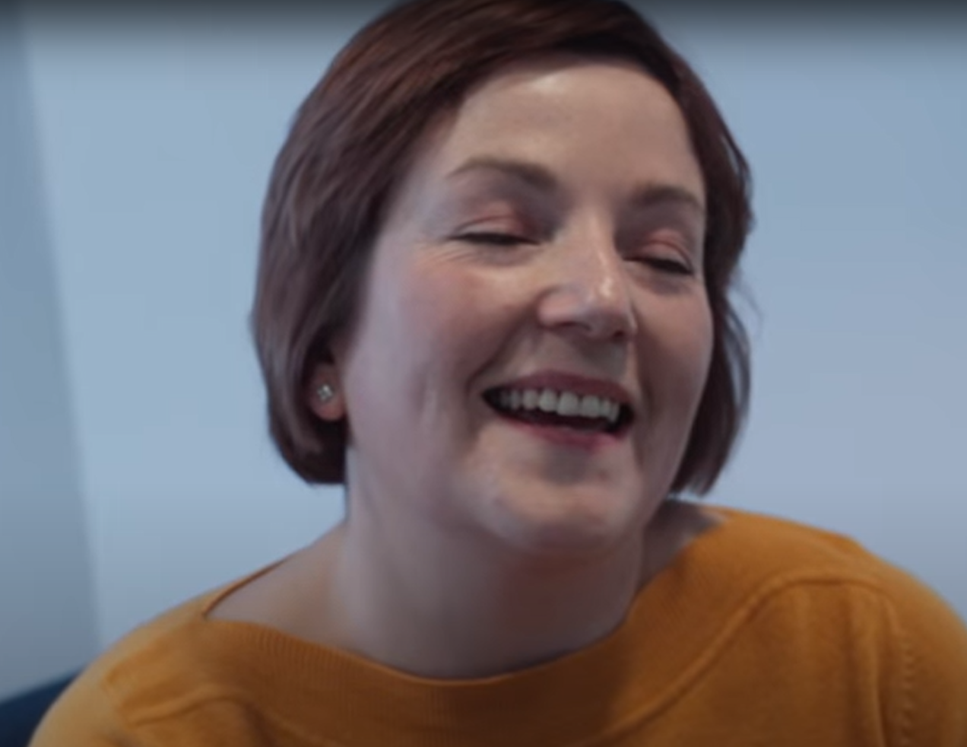
Learn more: What makes the NHS unique?
In this week’s assembly, you can find out more about the NHS, such as when it first began, how many people work there, and how it has changed over the years. You will also hear about some of the jobs people have, and how we can show our appreciation for it!
0:00-1:53
Career Spotlight:
This is Ruth. She works in the NHS as a Clinical Healthcare Scientist. Health information takes many forms, and scientists like Ruth test patient samples and provide results for other healthcare professionals. Click the image to hear about Ruth’s journey from school through to helping people look after their health today!
https://safeshare.tv/x/ltur9RLrY4o
Notes:
Alternative Video Link: https://www.youtube.com/watch?v=ltur9RLrY4o
Images
iStock
References
https://www.hdruk.ac.uk/what-is-health-data-research/health-data-research-explained/

Slide 26
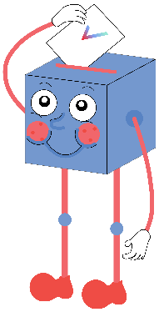
Should we share our medical data?
Sharing our data will help researchers and scientists understand how to help us better.
Knowing what medical conditions people have will allow the Government and NHS to plan to give us the best care.
Medical data has been really helpful during the pandemic – it makes sense to keep going now!
…
Medical information is very personal – it shouldn’t be shared with strangers who don’t know us.
If a mistake did happen, and the data was shared with the wrong people, it could affect us badly.
Medical data can be helpful, but it also personal, so no one’s data should be shared if they don’t want it to be.
…
We will be sharing your thoughts on this topic with The Health Foundation, NHS Digital, Minister of State for Media & Data, Secretary of State for Health & Social Care, and the Information Commissioner's Office (ICO).

Slide 27
Visit our website to have your voices heard!
Teachers: For a refresher on how to log your votes, please click here. And for any other issues, feedback or comments, email primary@votesforschools.com.
Notes:
Alternative Video Link: https://www.youtube.com/watch?v=N0-AjP3cFjg&feature=youtu.be

