Slide 2
Feedback: “Is cyber security important to you?”
“Like a lot of children would be, I am very scared of being hacked. Cyber security made me realise just how much stuff can be stolen online! I will be much more careful from now on. We need to protect all our information! I loved learning this topic. It really opened my eyes.”
North Mead Primary Academy
“Cyber security doesn't matter to me because I don't fill in forms that ask me for any personal information. I also think that once you know what to do or you use gaming websites you get used to being online and nothing seems scary.”
Queensbridge Primary School
Yes
No
91.5%
8.5%
“I don’t think cyber security is important to me because when you get a phone or an Xbox … our mums or dads will tell us what we can do and what we can’t anyway."
Engayne Primary School
“We don't want the bad guys getting into our information.”
Atlas Academy

Slide 3
Feedback: “Is cyber security important to you?”
As you may remember, we worked with the National Cyber Security Centre and IBM on this topic. Here’s what they had to say about the results!
“Thanks so much for taking part … It’s really important that we have a clear picture of how future generations view the importance of cyber security so we can shape our services to make the UK the safest place to live and work online.”
(Find the full quote in the Notes, or click the logo to find out more about being CyberAware.)
0:00-1:42
Click the image to hear from Jo McClear at IBM, who has made a special video just for you!
The VoteTopic results were also shared with…
CEOP
UK Safer Internet Centre
Internet Matters
https://safeshare.tv/x/C4hvmyaGwwg
Notes:
Alternative Video Link: https://youtu.be/C4hvmyaGwwg
Full quote (NCSC): “Thanks so much for taking part in the VoteforSchools question ‘Do we take cyber security for granted?’ It’s really important that we have a clear picture of how future generations view the importance of cyber security so we can shape our services to make the UK the safest place to live and work online.
Working for the National Cyber Security Centre, we get to see thousands of examples of unlawful attempts to disrupt critical services, steal money and personal information. Some of the attacks are huge and affect many thousands of people but many are much smaller in nature and are specifically targeted at individuals. It’s why we have put together some really clear advice on how you can help protect yourself by being Cyber Aware . The internet and digital connectivity are wonderful tools and part of our everyday life and by doing a few basic things right, we can continue to enjoy them safely and securely.
Top tips:
Check to see if your email has been compromised - https://haveibeenpwned.com/
If your account has been compromised, check out https://www.ncsc.gov.uk/guidance/recovering-a-hacked-account
If you receive a suspicious email you can report it at report@phishing.gov.uk
Interested in learning more about Cyber Security and keeping the UK safe https://www.ncsc.gov.uk/cyberfirst/overview”
Images
Courtesy of CyberFirst
https://commons.wikimedia.org/wiki/File:IBM_logo.svg
https://en.wikipedia.org/wiki/Child_Exploitation_and_Online_Protection_Command
https://seeklogo.com/vector-logo/302534/uk-safer-internet-centre
https://twitter.com/im_org

Slide 4
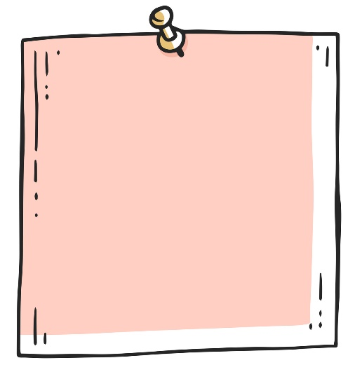
Starter: I’ve seen…
Discuss… (3-5 mins)
Put your hand up to share with your class a time that you have…
…Seen something funny on the internet
…Seen something scary on the internet
…Seen something interesting on the internet
Challenge:
Think about the types of things that you see on the internet. Are they mostly funny, interesting or scary?
Notes:
Images:
iStock

Slide 5
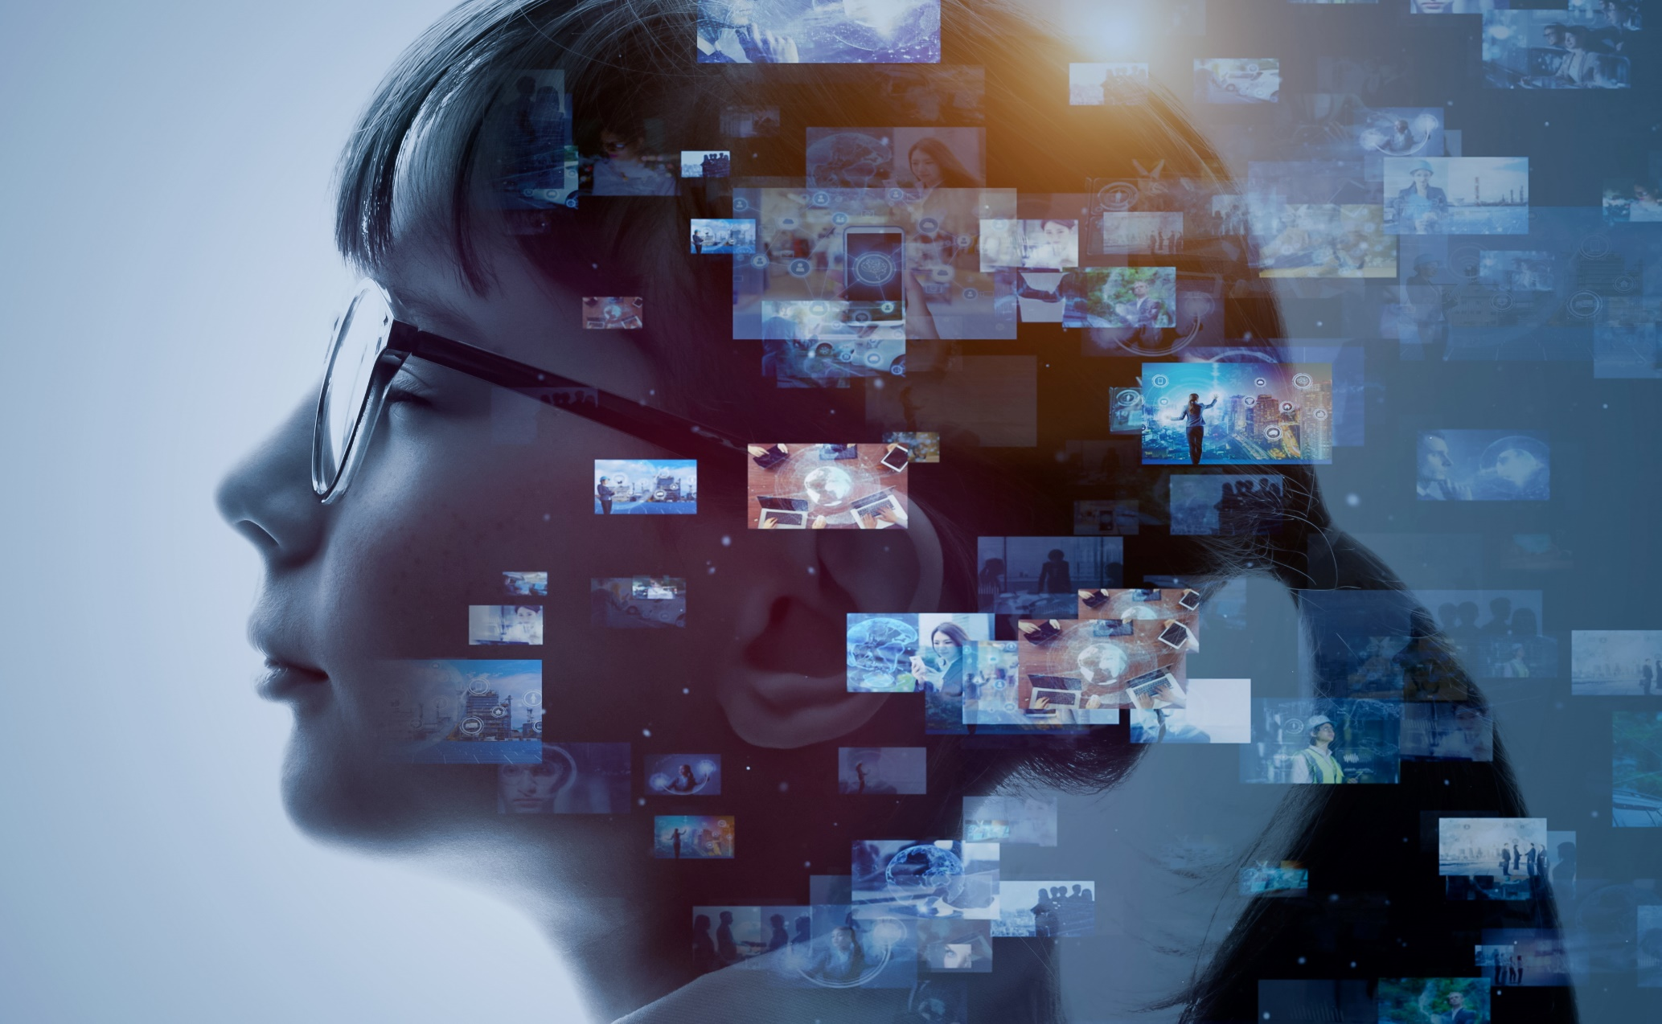
Has lockdown made the internet more dangerous?
Notes:
Images
iStock

Slide 6
Starter: I’ve seen…
Why are we talking about this?
Is it radical?
How does it happen?
The online world…
Ext: A toolkit for worries
Vote!
Notes:
Images
Icons8

Slide 7
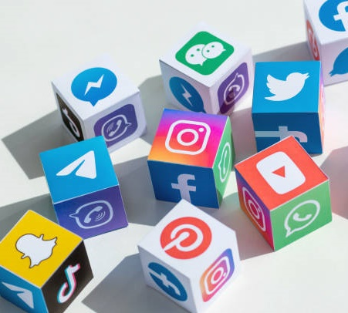
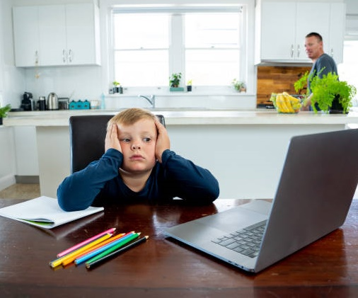
Why are we talking about this?
It’s been nearly a whole year since schools closed and the UK went into its first lockdown!
And when you’re at home all day, it’s very likely that you’ve been using the internet to keep yourself busy.
From video calls, to online games, to watching a little bit too much YouTube, there’s lot of things to do when you are online.
But with more people than ever before using the internet regularly, there have been worries that lockdown has made the online world less safe than before.
That’s why this week, we’ve teamed up with the Counter Terrorism Police to find out what you think about life online during lockdown.
Notes:
Images
iStock
Counter Terrorism Policing

Slide 8
Starter: I’ve seen…
Why are we talking about this?
Is it radical?
How does it happen?
The online world…
Ext: A toolkit for worries
Vote!
Notes:
Images
Icons8

Slide 9
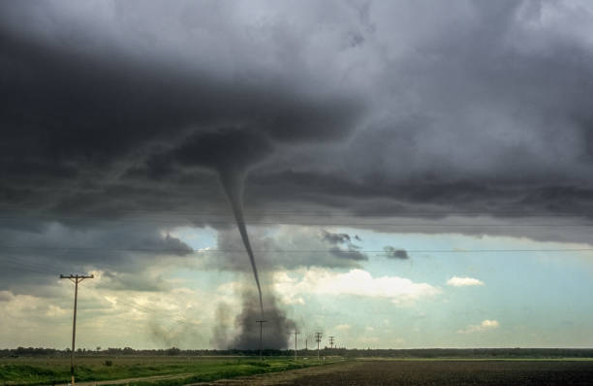
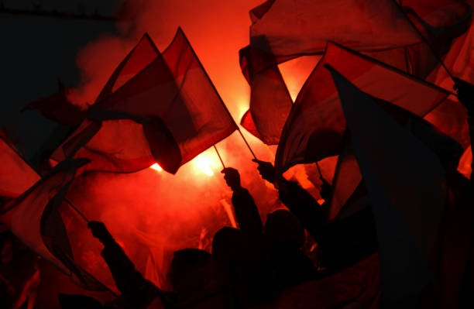
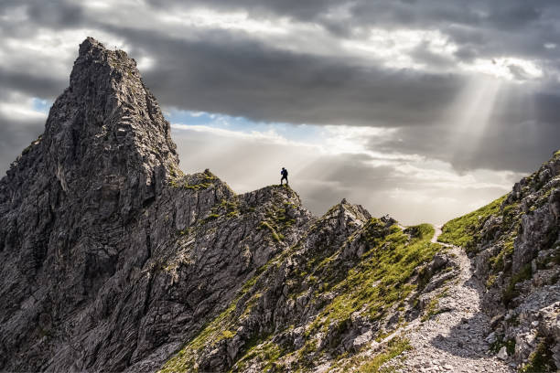
Is it radical?
The Counter Terrorism Police do lots of jobs to help keep up safe. An important part of their work is to try to stop people from becoming radicalised… But what does this mean?
To understand what radicalisation is, we first need to know what the word extreme means.
If something is extreme, it is very far from the normal. For example, we sometimes have extreme weather.
We might do extreme things, such as raising a large sum of money by skydiving or mountain climbing!
Or, we might hear extreme ideas or views.
Notes:
Images:
Counter Terrorism Policing
iStock

Slide 10
Is it radical?
Extreme or not? (3-5 mins)
Click to see some different views and opinions. It’s your job to decide if you think that they are extreme or not. If you think it is extreme, stand up. If you think that it is not, sit down.
It’s extreme!
It’s fine!
Everyone should be forced to follow the same religion.
Rubbish bins should be destroyed. We should all live a zero-waste life.
Reading should be banned. In fact, all books should be burned.
Anyone who commits a crime should go to prison for the rest of their life.
All of these are examples of extreme views.
Over to you! (2-3 mins)
How did reading these examples make you feel? Could you change any of them so that they aren’t extreme anymore?
Notes:
Images:
1) Icons8

Slide 11
Is it radical?
We all have different views and most of the time this is a good thing. It’s what makes us all unique!
It’s also important to make your voice heard about your views, and there are lots of ways that you can do this.
Extreme or not? (3-5 mins)
Take a look at these methods of making your voice heard. Once again, it’s your job to decide whether you think that they are extreme or not.
It’s extreme!
It’s fine!
Sharing your ideas with your friends
Joining a peaceful protest
Saying unkind things about people who have different views
Challenge:
Can you think of a real-life example where you have seen a person or group of people use extreme methods to make their voice heard?
Writing to your MP
Attacking people that don’t agree with you
Notes:
Images:
1) icons8

Slide 12
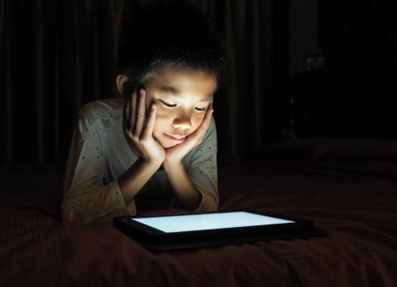
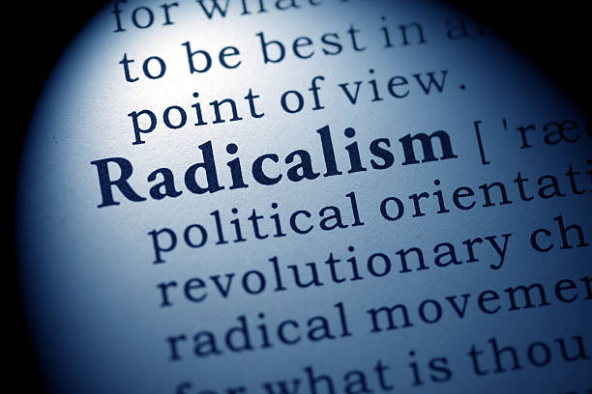
Is it radical?
When we are online, we can see and hear lots of different opinions. This can be a good thing, because we can learn more about the world and about how other people feel.
Of course, we all want to share our opinions too – it’s how we make friends! Everybody likes to discuss the things that they like, dislike, and are important to them.
However, this can also mean that we might see or hear some opinions that are extreme. If we hear these opinions often, we might start to believe they are true.
If someone is radicalised, it means that they have been made to have more extreme views. This can happen in many ways.
Notes:
Images:
1) iStock

Slide 13
Starter: I’ve seen…
Why are we talking about this?
Is it radical?
How does it happen?
The online world…
Ext: A toolkit for worries
Vote!
Notes:
Images
Icons8

Slide 14
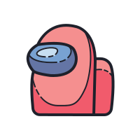
How does it happen?
Now that you know what radicalisation is, you’re going to find out how it can happen online.
Spot the problem (7-15 mins)
On the next few slides, you are going to see some different stories where the characters are at risk of being radicalised. For each one, see if you can answer the three questions at the bottom of each slide.
What was the first warning sign that you noticed?
What extreme views can you see?
If you were them, what would you do now?
Notes:
Images:
Icons8
iStock

Slide 15
How does it happen?
Since lockdown I’ve felt so lonely. I only talk to my friends during online learning, and their parents won’t let them go for a bike ride or come play at the park.
I find school really hard, especially when it’s online, and my parents can’t help because they’re always working. To be honest, I’m starting to give up.
Someone added me on this game I play and they helped me with some of my schoolwork. They say that when I’m done with school I can go work for them. They’ve even given me a free pass on Fortnite! The only thing I have to do to get the pass is watch a private video on “defending our culture” and “standing up for our country”.
What was the first warning sign that you noticed?
What extreme views can you see?
If you were them, what would you do now?
Notes:
Images:
Icons8
iStock
References:
1) https://ec.europa.eu/home-affairs/sites/homeaffairs/files/what-we-do/networks/radicalisation_awareness_network/about-ran/ran-h-and-sc/docs/ran_hsc_grooming_for_terror_25042019_en.pdf

Slide 16
How does it happen?
I’ve been gaming more since lockdown began. I watch a lot of streams, and am part of a group that talks about them too.
The guys are nice, and really good at the game, but they sometimes make horrible comments if someone from another country wins the game.
Last week, they kicked one of my friends out of the group because he didn’t have the same skin colour as us. They said that my friend should “join a group with their own people” instead, as they would “fit in better there.”
What was the first warning sign that you noticed?
What extreme views can you see?
If you were them, what would you do now?
Notes:
Images:
Icons8
iStock
References:
1) https://ec.europa.eu/home-affairs/sites/homeaffairs/files/what-we-do/networks/radicalisation_awareness_network/about-ran/ran-h-and-sc/docs/ran_hsc_grooming_for_terror_25042019_en.pdf

Slide 17
How does it happen?
When I’m older I want to be a TV presenter, so I’m practising now by making videos on my favourite app. I post short videos that tell people what’s been happening in the news!
I’ve been trying to make them funny, but also use the news to help make sure they’re true. I keep getting comments that say that I’m a liar.
The comments say that vaccines are dangerous, and that the pandemic is “just a big plan by the Government.” At first I thought they were just trolls, but they sent me some videos to watch and now I’m not sure what to believe.
What was the first warning sign that you noticed?
What extreme views can you see?
If you were them, what would you do now?
Notes:
Images:
Icons8
iStock
References:
1) https://ec.europa.eu/home-affairs/sites/homeaffairs/files/what-we-do/networks/radicalisation_awareness_network/about-ran/ran-h-and-sc/docs/ran_hsc_grooming_for_terror_25042019_en.pdf

Slide 18
How does it happen?
I’ve always had anger problems and I find it really hard to stay calm. My new school helped me with my anger and built my confidence up, but since lockdown started it’s getting worse again.
Making things and building models usually makes me feel better, so I started playing Minecraft and made some new friends. It helps to talk about my anger – particularly when I’ve had a bad day.
My new friends say my anger is normal and there’s so much to be angry about. They say we need to join together and start planning a fight against the Government, so that we can make our voices heard and fix the problems in the world.
What was the first warning sign that you noticed?
What extreme views can you see?
If you were them, what would you do now?
Notes:
Images:
Icons8
iStock
References:
https://education.minecraft.net/wp-content/uploads/Minecraft-Education-Edition-Multiplayer-Guide-1.pdf
https://ec.europa.eu/home-affairs/sites/homeaffairs/files/what-we-do/networks/radicalisation_awareness_network/about-ran/ran-h-and-sc/docs/ran_hsc_grooming_for_terror_25042019_en.pdf

Slide 19
How does it happen?
Now that you’ve seen how radicalisation can start, take a moment to think about this week’s question…
Reflect (2-3 mins)
On the next slide, you are going to see four different opinions. Read each one, then move to the side of the room that you agree with the most.
Not in the classroom?
Show your answer by pointing to the corner of the screen that you agree with the most!
Worried about what to do if these things happen? Find out more in the final activity!
Notes:
Images:
Icons8
iStock

Slide 20
How does it happen?
These things don’t really happen on the internet, at least not to me.
Lockdown doesn’t make a difference to these problems. They were just as bad before lockdown.
While these problems always happened, lockdown has made them worse.
Most of these problems are only happening because of lockdown. The internet was safer before.
Worried about what to do if these things happen? Find out more in the final activity!
Notes:
Images:
Icons8
iStock

Slide 21
Starter: I’ve seen…
Why are we talking about this?
Is it radical?
How does it happen?
The online world…
Ext: A toolkit for worries
Vote!
Notes:
Images
Icons8

Slide 22
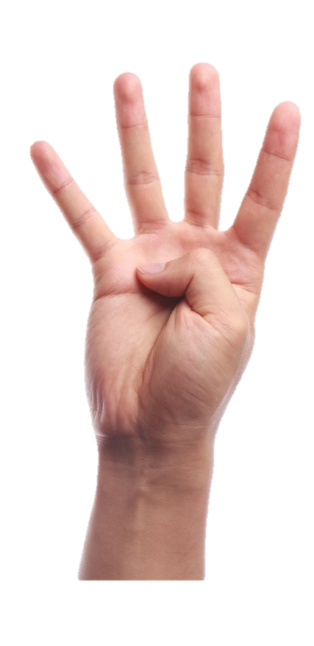
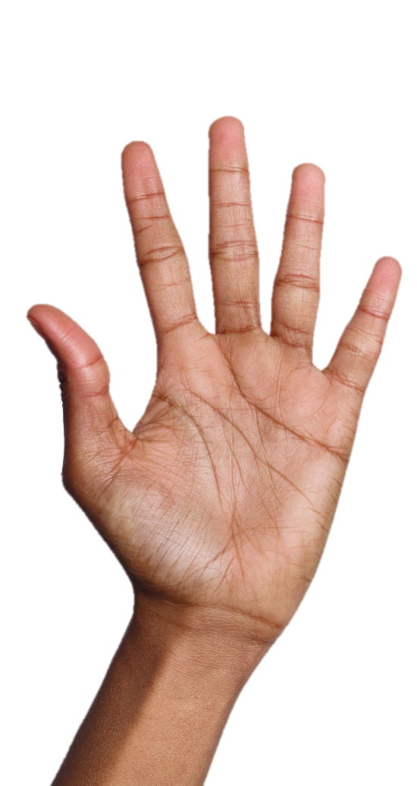
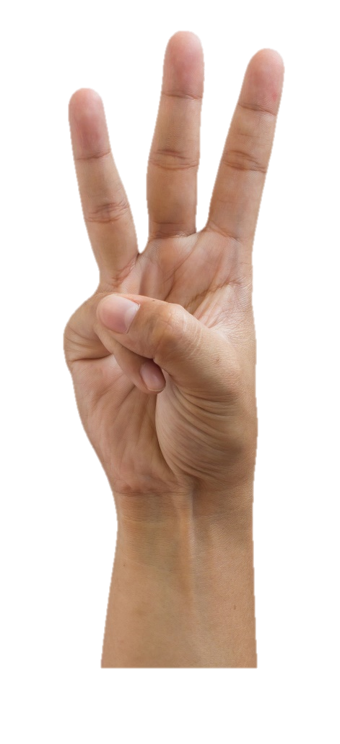
The online world…
Different opinions… (4-12 mins)
On the next four slides, you are going to see some different opinions on the way that you use the internet. For each one, show your opinion using your fingers.
I totally disagree
I slightly disagree
I’m in the middle
I slightly agree
I totally agree
Notes:
Images:
iStock

Slide 23
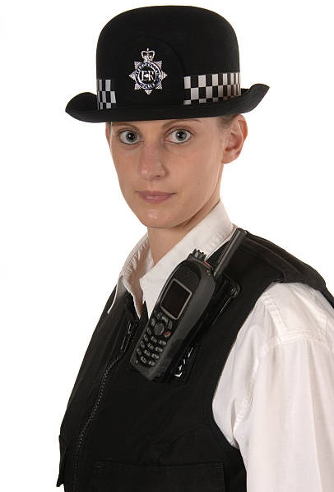
The online world…
Young people are much more likely to be radicalised because they are online the most, and they might not know how to spot the signs yet.
I totally disagree
I slightly disagree
I’m in the middle
I slightly agree
I totally agree
Notes:
Images:
1) iStock

Slide 24
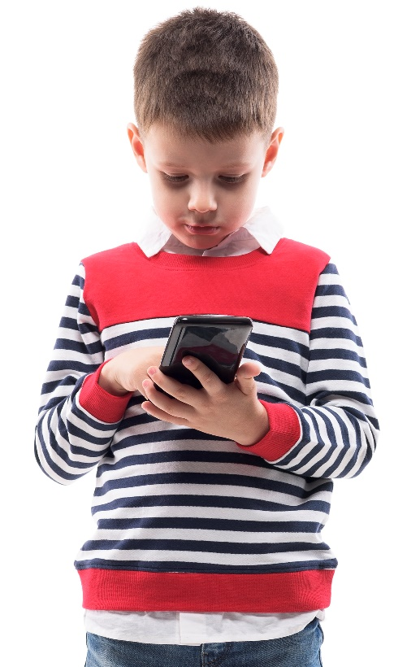
The online world…
It actually gets quite annoying when people keep telling us to be safe online in different ways. We’re online all the time – we know how to be safe!
I totally disagree
I slightly disagree
I’m in the middle
I slightly agree
I totally agree
Notes:
Images:
1) iStock

Slide 25
The online world…
Children might be online more during lockdown, but parents always know what they are doing online, and make sure that they are safe.
I totally disagree
I slightly disagree
I’m in the middle
I slightly agree
I totally agree
Notes:
Images:
1) iStock

Slide 26
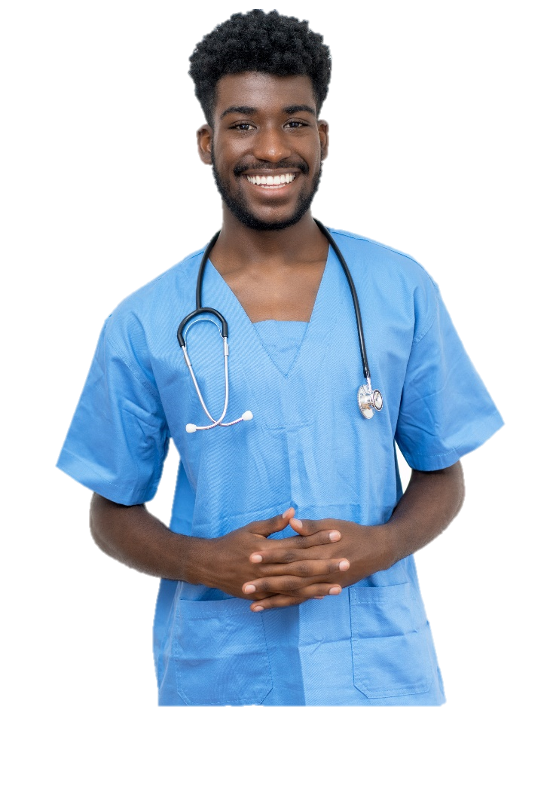
The online world…
When we speak to someone new, we want them to like us, so we might “go along” with what they say, even if we don’t agree. Later, this can cause problems…
I totally disagree
I slightly disagree
I’m in the middle
I slightly agree
I totally agree
Notes:
Images:
1) iStock

Slide 27
Starter: I’ve seen…
Why are we talking about this?
Is it radical?
How does it happen?
The online world…
Ext: A toolkit for worries
Vote!
Notes:
Images
Icons8

Slide 28
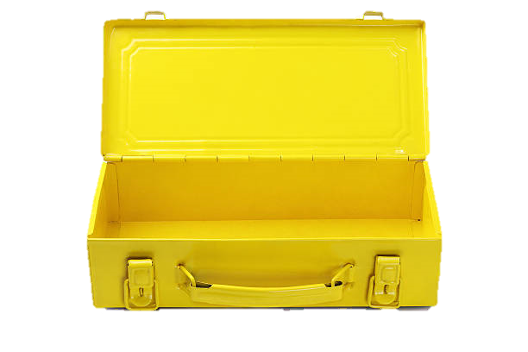
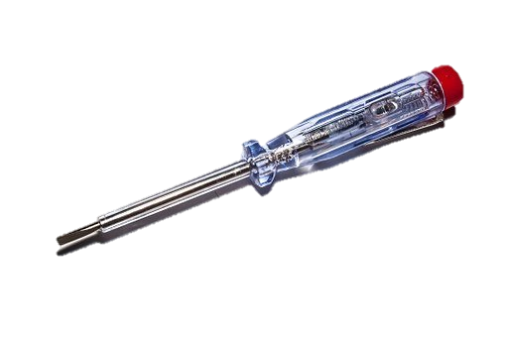
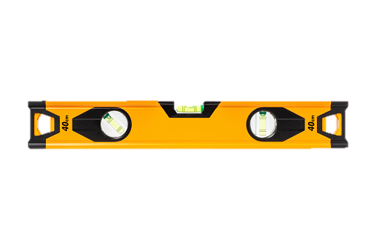
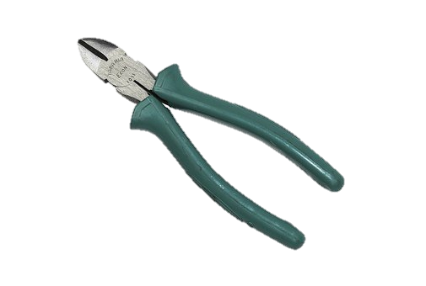
Ext: A toolkit for worries
We all know that the internet can be an unsafe place, but it can also be an amazing place to talk to your friends, find out new things and share your own ideas.
As long as we know how to stay safe online, we can do all of these things and stay away from dangers like extreme ideas and radicalisation.
Safety tools! (2-3 mins)
Imagine you were designing a toolkit to help other children to stay safe online. Which “tools” would they need to know? Use the questions to help you.
Need ideas?
Head to the next slide!
What do they need to watch out for?
What should they do if they see something worrying?
Who can they speak to about their worries?
Notes:
Images
Pixabay
Icons8

Slide 29
Ext: A toolkit for worries
Look out for ideas that seem extreme
Ask questions calmly
Check you have the real facts
Think before you share
Challenge:
What other tools would you include in your toolbox? Why not share your ideas with a friend and see what ideas they have!
Talk to a teacher or trusted adult
Don’t be afraid to block, delete & ignore people
Notes:
Images
Pixabay

Slide 30
Starter: I’ve seen…
Why are we talking about this?
Is it radical?
How does it happen?
The online world…
Ext: A toolkit for worries
Vote!
Notes:
Images
Icons8

Slide 31
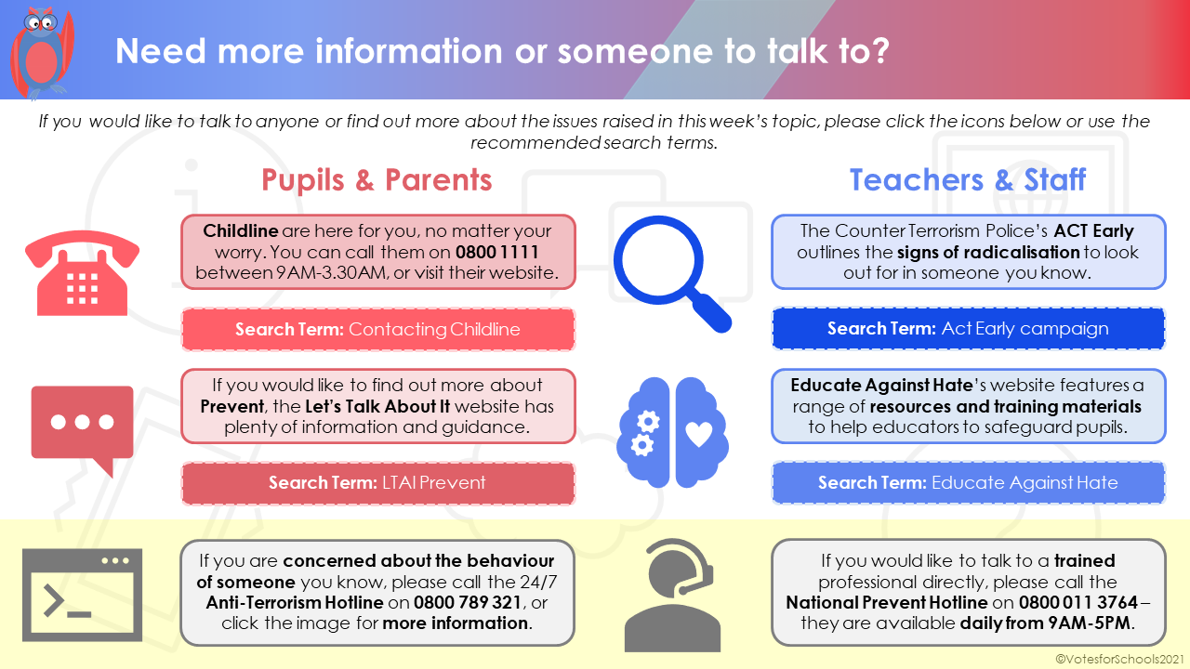
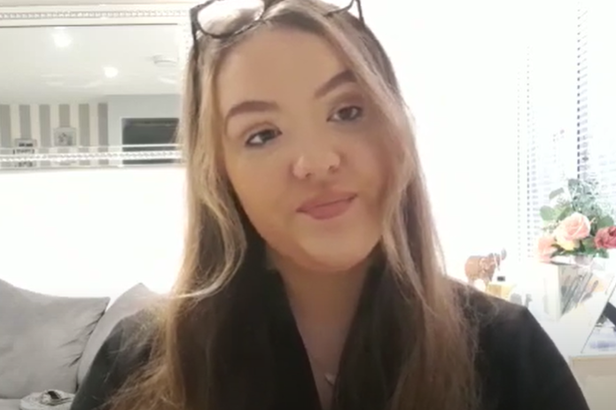
Learn more: Need some advice?
As this week’s topic has dealt with some tricky issues, we have put together a list of recommended places to visit as part of this week’s Home Information Sheet - if you don’t have this already then please ask your teacher for a copy.
0:00-0:55
Career Spotlight:
This week’s video comes from a very special person: our Intern, Libby! She is currently in her final year of university and is working for VotesforSchools as part of a placement (and she’s doing a great job so far!). Click the image to find out more about her links to this week’s topic and her future plans.
https://safeshare.tv/x/wI-DQOMg0ZE
Notes:
Alternative Video Link: https://youtu.be/wI-DQOMg0ZE
Images
VfS
Via video

Slide 32
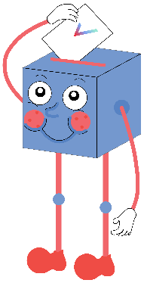
Has lockdown made the internet more dangerous?
Everyone is online now more than ever before, so the dangers are easier to see.
Lockdown has made some people feel lonely and sad, which makes them easier to radicalise, and the internet has made this even worse.
For young people who don’t know all of the dangers of the internet, lockdown has made it more dangerous.
…
It’s not the internet that is more dangerous – it just feels that way because we’re using it more.
Most people just avoid dangerous things like radicalisation online, so it doesn’t really affect them.
Young people have grown up with the internet, so we already know how to keep ourselves safe from these dangers.
…
We will be sharing your thoughts on this topic with The Counter Terrorism Police, the NSPCC, Childline, The Children's Society and comedian Guz Khan!

Slide 33
Vote!
In the classroom?
Log your class’s votes now at: www.votesforschools.com/login/teacher
At home?
Follow this link to vote: https://www.surveymonkey.co.uk/r/vfs-primary-lockdown-internet
Not sure how?
Click the ballot box to see a video on how to log your votes!
Having trouble?
Copy and paste the link into your internet browser!
If you have any issues, feedback or comments, email primary@votesforschools.com.
Notes:
SurveyMonkey Link: https://www.surveymonkey.co.uk/r/vfs-primary-lockdown-internet
SafeShare How-To Video Link: https://safeshare.tv/x/N0-AjP3cFjg
YouTube How-To Link: https://www.youtube.com/watch?v=N0-AjP3cFjg&feature=youtu.be

